Slide 1
Module 5
Melvin C Jose

Slide 2
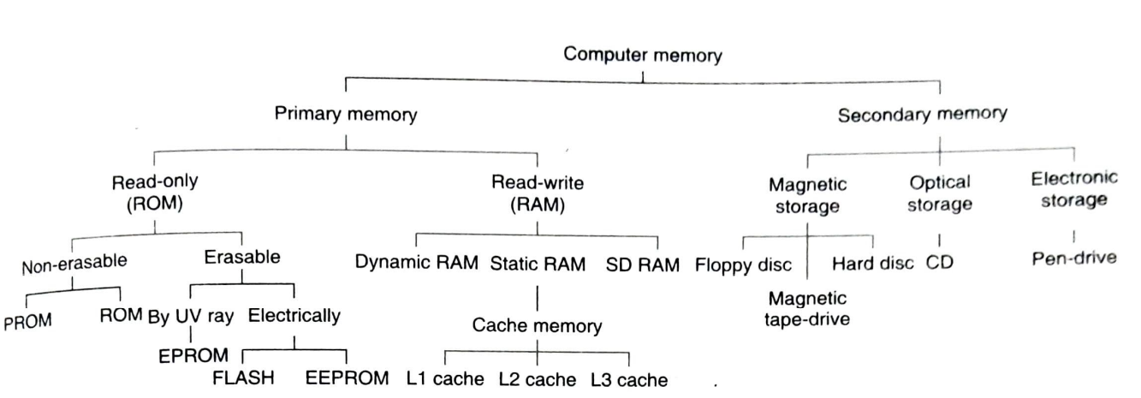
Computer Memory Tree

Slide 3
Types of Computer Memory
ROM – Read only memory (Nonvolatile memory)
Store information in power off conditions
It help to Boot the system
RAM – read write memory (Volatile Memory)
Processor, ROM and RAM is minimum system requirement

Slide 4
Types of Computer Memory
Based on Erasing the programs
We need special writing methods
And special wiping methods
Even the programs remain there even if it get switched off
Types
PROM
UV PROM
EEPROM
EPROM
FLASH

Slide 5
ROM
Erasing is not possible at all
Factory Fabricated
Programs are the basic forms in the structure of their silicon wafer
Mass production
Very cheap

Slide 6
PROM(Programmable Read only Memory)
Only One time Programming(OTP)
Then holds data forever
More flexibility than ROM
So More expensive than ROM

Slide 7
EPROM (Erasable Programmable Read Only Memory)
Facilitates with programmability
Suitable for any Prototype development
More expensive than PROM
Completely erased by exposing to UV radiation(More than 15 Minutes)
Small transplant quarts window is provided

Slide 8
EEPROM(Electrical Erasable Programmable read only Memory)-EPROM
Time required to erase the program is milliseconds
Much less than EPROM
More suitable for software development and testing
Writing and erasing are used 5V DC

Slide 9
FLASH
Very much similar to EEPROM
EEPROM is byte-wise erasable whereas flash is not

Slide 10
RAM(Read/Write Memory)
If power goes information goes( need battery back-up)
Types
SRAM
DRAM
SD RAM

Slide 11
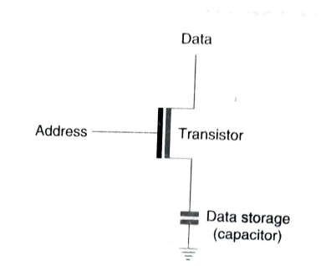
DRAM(Dynamic RAM)
One transistor or FET with a capacitor to store one bit information
Large number of storage cells can accommodate in the memories
Stored as electrical charge with in capacitors
It is an analog method
Can refresh periodically
Comparably slower devices
Commonly used as main memory in computer
systems

Slide 12
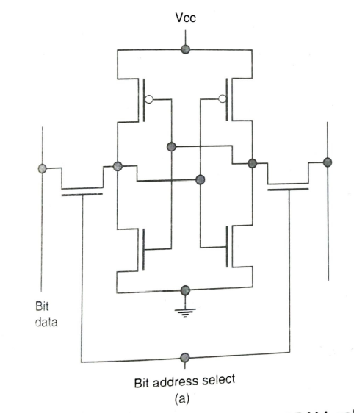
SRAM(Static RAM)
Fastest RAM
More expensive and need more number of transistors to retain each bit
Retain each information in Flip-Flops
Used in cache memory of computers
All internal registers of any processor composed of SRAM

Slide 13
SDRAM (Synchronous DRAM)
It is hybrid of DRAM and SRAM
Faster than DRAM
Main memories are made from SDRAM

Slide 14
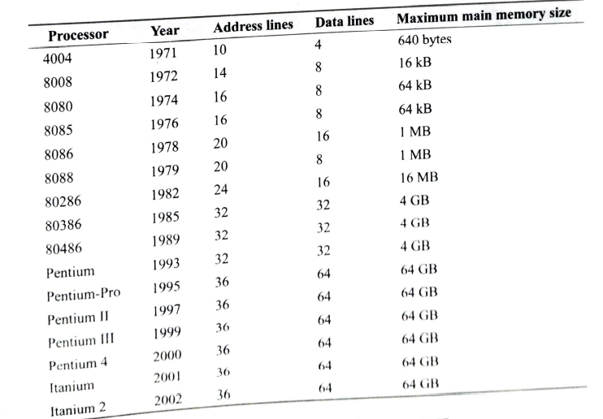
Main Memory
Any of this memory(DRAM) can set as Main memory
It is interfaced with the processor through a DRAM controller using Data and control bus of the processor
Size of the main memory directly depend on number of address lines

Slide 15
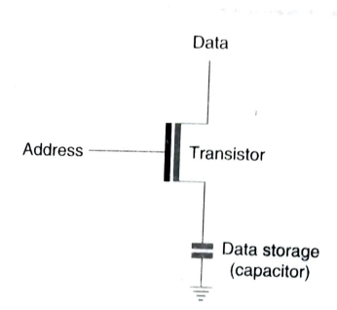
Main Memory reading and writing
Writing of data
If address line is high transistor is active(On state)
Then the physical condition of data line will get duplicated in capacitor in the form of analog voltage (charged/discharged).
Reading of data
If address is triggered status of capacitor voltage is available in data line
It is read through comparator out side
Capacitor has a tendency to discharge
Original status of capacitor maintained by refreshing capacitors(refreshing of DRAM)
It is done with the help of DRAM controller

Slide 16
DRAM Refreshing
Done by DRAM (Array) controller
For this there are two signals
RAS (Row address Strobe)
CAS (Column address strobe)
These signals help to refresh the memory bits at the time of reading

Slide 17
Secondary Memory
Non volatile
Stores information in the form of data or program
The data in secondary memory should load to primary memory before execution
Types
Hard Disc
Optical Disc
Magnetic tapes etc.

Slide 18
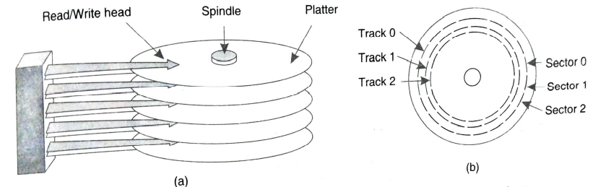
Hard Disc
Magnetic coating on both side of platter
Each plate has its read/write head(top and bottom)
Each plate is connected to Spindle which is motor driven
Where head movement and platter rotation is synchronized
Each plate is subdivided in to tracks and sectors
Between track and sectors there is a separation
One sector can store 4 kilo-bits along with track and sector information
Here accelerometer as sensors

Slide 19
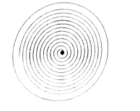
Optical Disc
Reflection of light source is the guiding factor for communicating digital information
For reading and writing laser beams are used
Pits(undulations) and land are created to read/write status 1/0 respectively.
Geometry of tracks is different(in the form of spiral) starting from centre
Sectors on this track

Slide 20
Memory Characteristics and Hierarchy
Memory stores programs and data and other information
The Memory System is categorized as based on three parameters
Access time
Cost of storage/bit
Affordable Convenient Size
All have equal importance

Slide 21
Access Time
The time necessary to complete a unit communication between Processor and concerned memory devices
It is the time delay between issuing the read command from the processor and arrival of target data within the processor.
Between registers and processor (Few Nano seconds)
Between processor and magnetic tapes (few seconds)
Access time should be minimum

Slide 22
Cost of storage per bit
Cost of storage bit is inversely proportional to Access Time.

Slide 23
Affordable Convenient Size
Same size of data storage in suitable size (Magnetic tapes) and some in impractical size(Silicon wafers)

Slide 24
Memory Hierarchy
Six verities of storage possibilities (All are not in the same system)
Registers (Closest to processor)
L1 Cache (With in the same chip of processor)
L2 Cache (primary cache within processor)
L3 cache (secondary cache outside the processor)
Main Memory (With in motherboard)
Disc drives and tape drives (outside Motherboard)

Slide 25
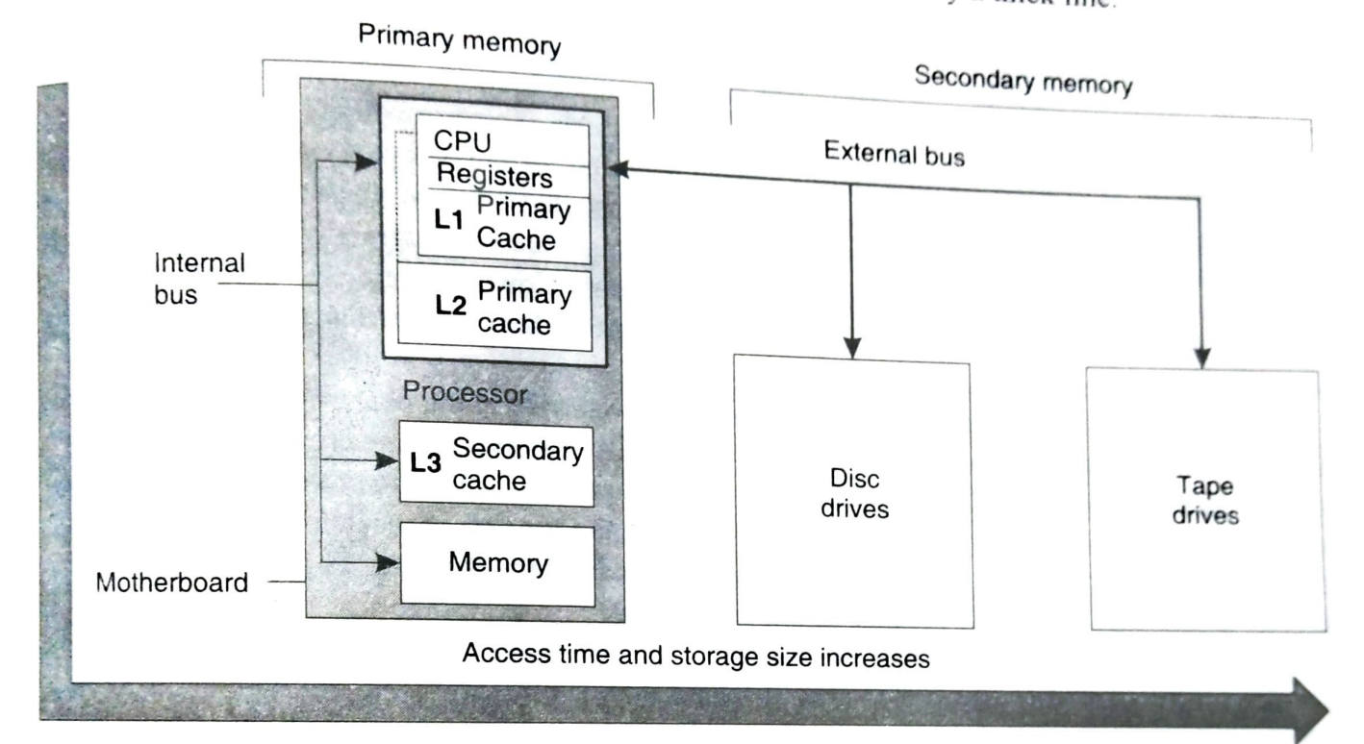
Memory Hierarchy

Slide 26
Memory Hierarchy
Memory located in Motherboard is called primary memory and outside motherboard Secondary Memory
CPU Wafer
Registers
L1 Cache(Similar to CPU Registers)
Processor package
CPU Wafer in one silicon Wafer
L2 cache in another Wafer
Motherboard Accommodating Processor
Processor package
L3 cache

Slide 27
Connecting Buses for these Modules
L1 cache connected with Processor’s internal Buses with in CPU
L2 cache connected with special internal buses
L3 cache and main memory are connected with processor through the address-data-control bus
Secondary memories are connected with processors through External bus
External bus also used for the connection of other peripherals

Slide 28
Virtual Memory
Programmers develops programs assuming there is memory available in the computer than in reality is virtual memory
Now a days memory is cheaper
Introduction of GUI required large memory for Software
Due to enhancement of memory size, efficient memory utilization is required (overlays)
Overlay
It is the technique used by programmers(software developers), It will load only required portion of program that is necessary for immediate execution to main memory.
Complete program on secondary memory

Slide 29
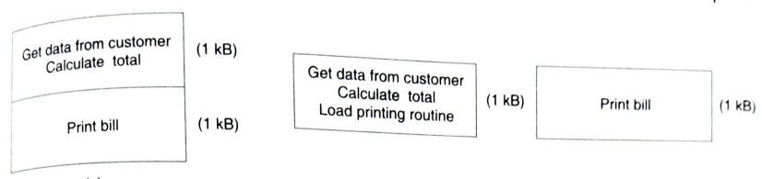
Overlay
Example of Overlay

Slide 30
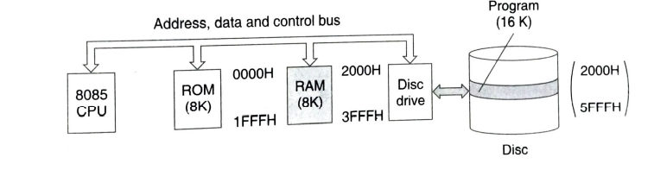
Virtual Memory
8085 has 16K memory divided as 8K ROM and 8K RAM
A secondary memory is attached where can store full program
Address of RAM starts from 2000 to 3FFF
16K program divides in to two 8K and executes separately in RAM(8K Virtual Memory).software 56KB long is also possible by this method
Change the relevant address is an issue to start the execution
Base-Offset addressing system is a remedy for this(Physical address generation)

Slide 31
Paging in virtual Memory
To make virtual Memory technique more effective, RAM area is sub divided in to smaller- sized pages(No specific rule for page size)
Then virtual memory becomes more systematic
The desired page size would be applicable for both RAM and secondary memory
Memory management unit keep tracking on free page available on RAM
If there is no free space The recently executed set of program or least recently used program will replace with next prior set of program
If page size is small the wastage of memory will less (Last page) memory management unit can easily handle

Slide 32
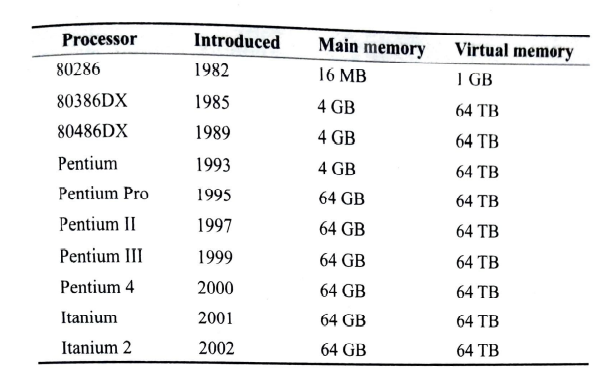
Virtual Memory in Intel Processors

Slide 33
Memory Management
Unit and technique for proper utilization of Memory
It is composed of both hardware and software
Major responsibilities of the memory manager
Protect the memory area from unwanted accidental access
Utilize the available memory area in best possible way for all relevant software
Other Duties
Keep track of entire memory space(both free an occupied)
Allot necessary spaces for respective program
Generate address as per the system requirements
Oversee the smooth running of the system in memory point of view

Slide 34
Cache Memory
For any program continuous execution and result must be store back to the main memory
So a continuous communication between processor and memory
It is time consuming and moreover it is observed that a small fraction of the program is repeating again and again by processor(for looping or iteration programs)
A computer jargon(locality of reference):- from a small area the processor fetches instruction again and again.
So a smaller sized SRAM to store these few instructions in a close proximity. It is nothing but a cache memory

Slide 35
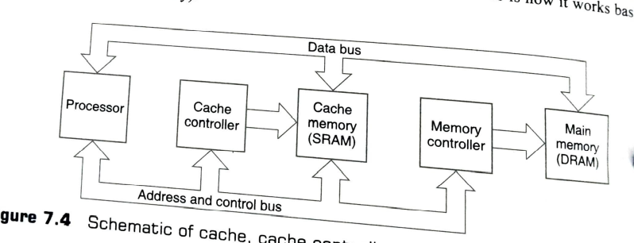
Schematic of cache
Processor needs next instruction
Send address through the bus
First it comes to cache controller
Check whether it is in cache
If it is not available, the address is released to the main memory controller and code is fetched from DRAM main memory
This code also passed through the cache controller
And stores it in cache for future usage
If again it requires the cache controller will provide directly
So we can save time
If it is group of instructions(repeating loops) saves much more time

Slide 36
Why cache required
Continuously increasing the speed of processor
Increasing the size of the main memory but it won’t make working of memory faster
Combination of these two is not beneficial
Processor is faster and main memory is slower
Two types of memory
SRAM(Less access time)
DRAM(Cost Effective, It offers much more storage area)

Slide 37
Classification of cache
In early stage single cache for both data and program Common cache or unified cache
Unified cache uses memory space effectively
If this cache is full it will over write by deleting some instruction
Later stage separate cache for program and data(Split cache)
Instruction cache
Data cache
It is free from over writing
Underutilization of memory space

Slide 38
Level of cache
Based on position(levels) of cache it is divided in to three for optimum performance of computer
The cache closest to processor is called level 1 (L1 cache).
It is the part of CPU
Both works at same clock speed as that of processor
It is very similar to CPU registers(considering access time)
There is a limitation in size since it is in same processor wafer

Slide 39
Level of cache
Level 2 cache(L2 cache) with in the same package of the processor but in a separate wafer
So l2 cache can offer more storage area.
Communication time is almost similar
Both L1 and L2 cache are designed as primary cache
Level 3 (L3 cache)
Usually outside the processor package
Affordable size is more compared with L1 and L2 caches
It take more time to communicate
It is designed as secondary cache

Slide 40
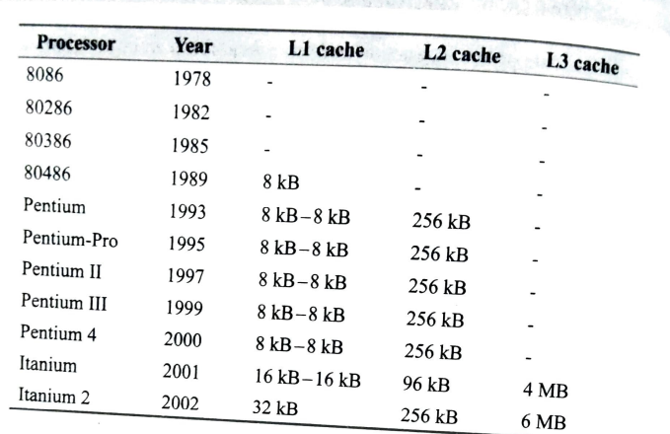
Cache in Intel Processors

Slide 41
Cache Hit and Hit Rate
The instruction or data, which is currently required by processor, is available within cache it is known as a cache Hit
If it is not available within the cache is known as cache miss
The number of such a cache hit is expressed as a percentage is known as hit Rate
In modern computers an average hit rate is 90%

Slide 42
Storing results in Cache
To store the computation result in a main memory cache is also taken part of this action
Two Methods,
Write through-Both Cache and main memory are updated simultaneously
Write Back – Cache will update immediately and main memory will update later stage
Two maintain correlation between the main memory and cache a cache directory is maintained by the cache controller
Cache controller having additional storage area to keep track of which portion of main memory contents is occupying certain area of cache
This is known as mapping

Slide 43
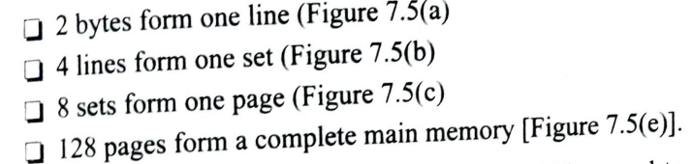
Mapping
There are three types of Mapping
Directed Mapped Cache
Set associative cache
Fully Associative cache
Directed Mapped Cache

Slide 44
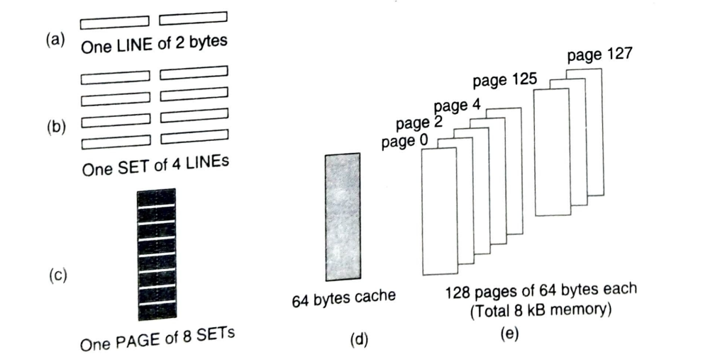
Schematic of direct mapped cache

Slide 45
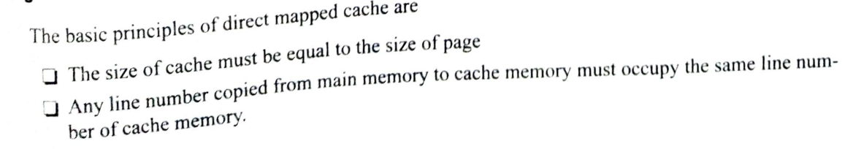
Schematic of direct mapped cache
In this cache 32 lines and 64 Bytes which is equal to one page size in main memory
If we copy Line 7 from any page of main memory it will get placed line 7 in cache memory(Only line wise, No byte wise)
To control cache ,there is cache controller and inside this cache directory or TAG-RAM(12 bit) to track cache

Slide 46
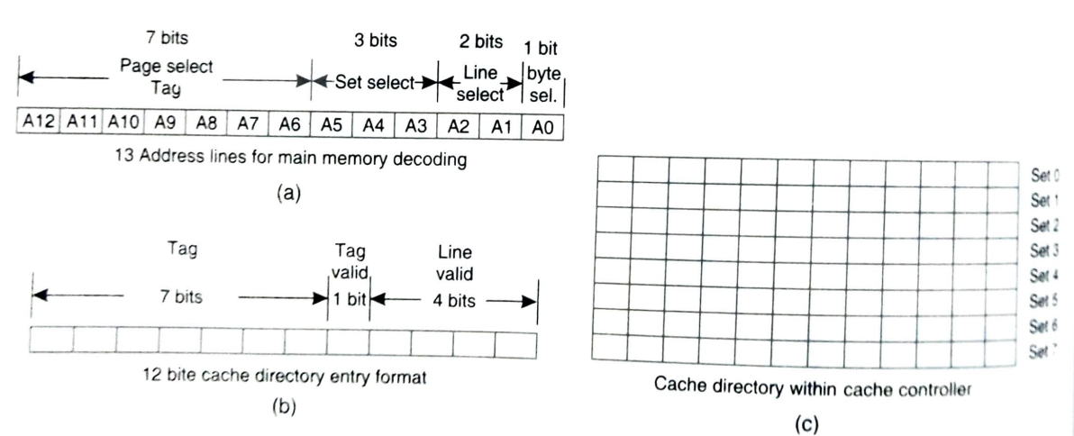
Cache Directory Entry Details
0 A1 | 0A2
1 | 0 | 0 | 0

Slide 47
13 bit Address of the processor
A6-A12(highest seven bits) of memory address used to select one of 128 pages of main memory
A3-A5 used to select one out of 8 sets within the target page
A1-A2 used to select one out of four lines of the selected set within the target page
The entire selected line will send to processor through cache controller

Slide 48
12 Bit Cache Directory
For each set, total of 8 set in cache have separate 12 bit locations are available within a cache directory
Out of these 12 bit the highest seven bit are reserved for TAG bits
Next one bit is act as TAG valid( Status 1) bit
Next four bits are act as line valid bits
This 12 bit format represents all four lines of the particular selected set

Slide 49
Working of Cache
If processor needs a line(not single bit so A0=0) it send its address out
This address is first captured by cache controller
From address using bits A3-A5 cache controller identify the set in the cache directory
Next it will compare the highest 7 bits of address with Highest 7 TAG bits in the cache directory
If it matches, it check TAG validity(Available or not)
If it valid then it read line information from bits A1-A2
The line valid bit of selected line is one(valid) in cache directory the required line is available in the cache(cache hit) other wise cache miss
Which can select from cache

Slide 50

If cache miss occurs Full address will send to memory controller
It reads the data from main memory
The data read is passed through cache controller stores it in cache with proper updates in cache directory
Line and set is followed same as in the main memory with the support of A1- A5

Slide 51

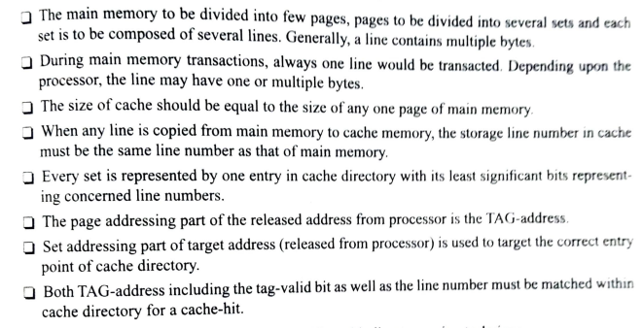

Slide 52
Set Associative Cache
Major disadvantages of Direct mapping technique is that the same lines in different pages is not available simultaneously to the processor
So there will continuous cache miss is known as thrashing
This disadvantage can be eliminated by introduction of set associative cache
It is generally designed as two-way or four-way
In two-way method two separate caches of same size as that of a page of main memory are provided.
These both caches are directed mapped cache(having same tagging technique)

Slide 53
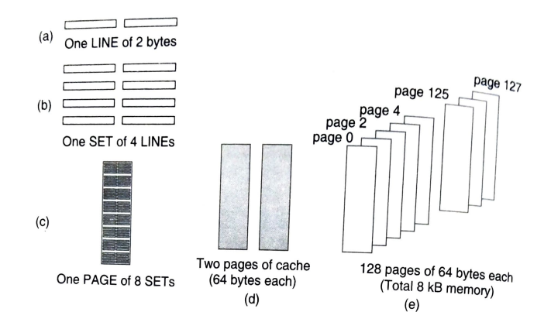
Two-Way set associative cache
There are two pages of cache, each having 64 bytes
In this case both caches are searched one after another

Slide 54
Fully Associative cache
Set associative caches are induced some amount of restriction against the same lines from too many pages
This method is free from this restriction
In this method any line from main memory may be placed any where in the cache
For this complete address is preserved as the tag address within the cache controller
To make response faster the search within controller is performed through hardware mechanism

Slide 55
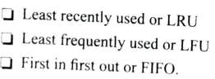
Replacement Algorithms
Caches are initially empty and it gets filled slowly by instructions and data as the work progressed
In direct mapping over writing is happens to use dedicated line number
For other two several algorithms are available

Slide 56
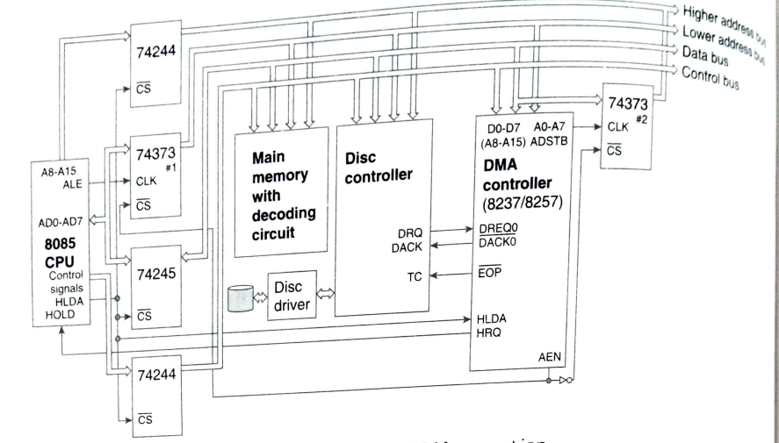
DMA(Direct Memory Access)

Slide 57
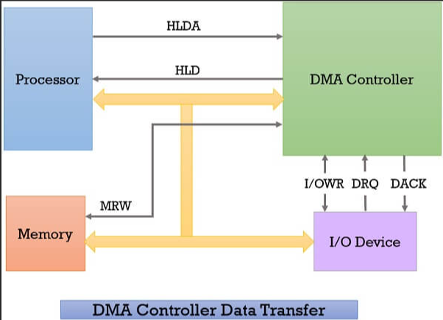
DMA
User specifies file
OS sends file name to disc controller
Disc controller locates file
OS sends file length to MM
MM assigns space in main memory
OS sends starting address and file length to DMA
OS asks disk controller to copy

Slide 58
DMA
It is the technique for direct communication between memory and other peripherals or devices, bypassing the processors
It is the combination of hardware and software
For a large set of data(not required processing) transferring normal path is a time consuming one which can be over come by this .method
It requires three state bus buffer
Normally processor handles the buses but during DMA operation DMA handles bus control

Slide 59
DMA
Bus buffers are connected to HLDA and normally it is low so, all buffers are ON
When DMA request come(HOLD =1) then HLDA=1, buffers will OFF
DMA controller is capable to generate 16 bit address
The address lines A8-A15 are multiplexed with D0-D7 and it is De- multiplexed with the support of ADSTB signal(Like ALE Signal)
There is two buffers 74373#1 and 74373#2,which is activated with the help of AEN signal generated by DMA
Normally 74373#1 is actvated and at DMA operation 74373#2 will get activated
DMA’s four lowest Address pins are bidirectional since in normal operation it will receive address from processor and in DMA operation DMA controller provides Address to other peripherals

Slide 60
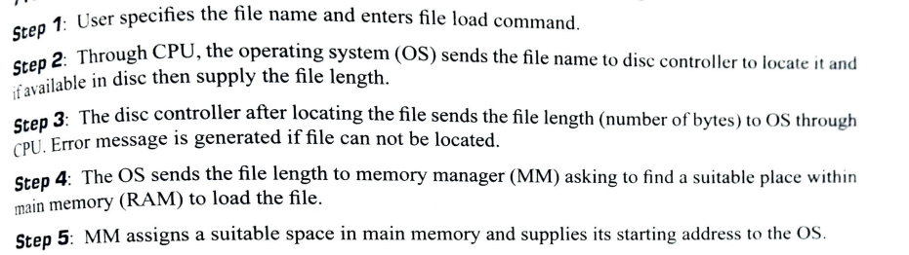
Steps for file reading operation using DMA

Slide 61
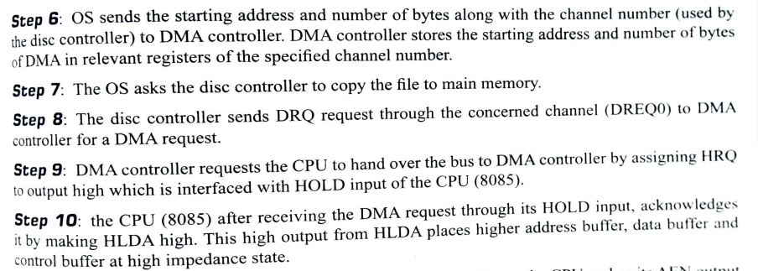
Steps for file reading operation using DMA

Slide 62
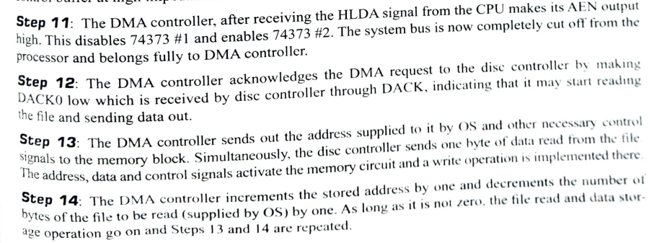
Steps for file reading operation using DMA

Slide 63

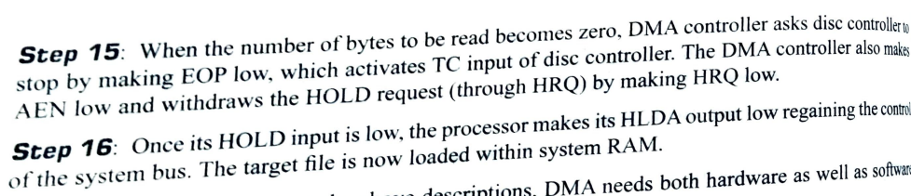

Slide 64
Input/output Organization
Basic requirements for a computer system is
Processor
Memory
I/O Modules
High speed interfacing of I/O modules need a high bandwidth(Video Interface)
Slowest I/O interface device is keyboard
In processor point of view other than memory all other devices are I/O devices
Examples Timer, Interrupt Controller USART,DMA etc.

Slide 65
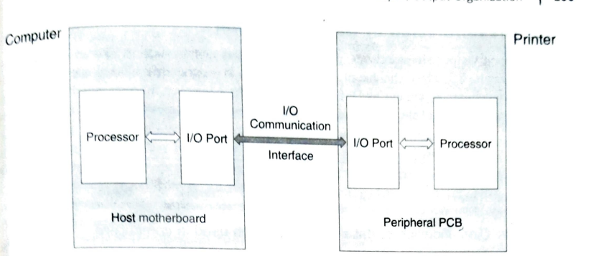
General Structure of any link between a host and its peripheral unit

Slide 66
General Structure of any link between a host and its peripheral unit
External peripherals are connected through any one of this method
Programmed I/O-Polling method (Asynchronous)
Interrupt driven I/O (Asynchronous)
Direct memory Access (Synchronous)
In programmed I/O processor knows when it transmit no idea when it receive so wait many states are there
In interrupt driven I/O the transaction begin with the interrupt signal from peripherals
Both this controlled by processor

Slide 67
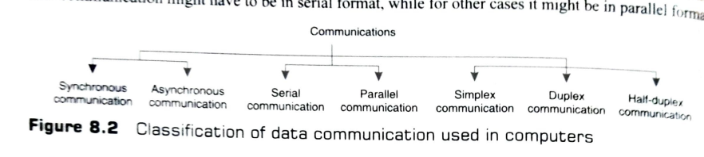
Classification of Communication
Depends on various characteristics

Slide 68
Synchronous and Asynchronous Communication
In synchronous communication a common clock governs the communication between any two devices
Ex. Communication between processor and main memory(System Clock)
It can finished within predefined time
Asynchronous Communication
Two devices in communication has different clock
Communication is completed with the help of handshaking signals

Slide 69

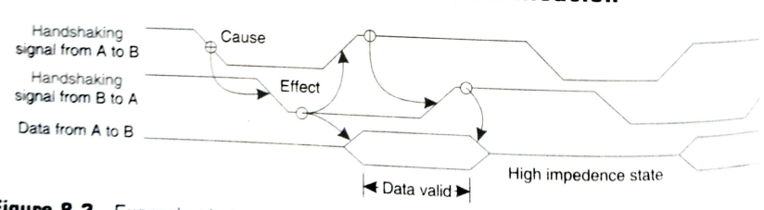

Slide 70
Module 5: The Memory System Types of memory - RAM, ROM. Memory Characteristics and Hierarchy. Cache memory – The basics of Caches, Mapping techniques, Improving Cache performance. Virtual memory – Overlay, Memory management, Address translation. Input/Output Organization – Introduction, Synchronous vs. asynchronous I/O, Programmed I/O, Interrupt driven I/O, Direct Memory Access.

